Slide 1
Interpreting polls

Slide 2
Why do we need good surveys?
Predict elections?
UNDERSTAND OURSELVES
To understand the balance of opinion in society
To understand shift in attitudes
To be able to separate noise from substance
– on the basis of reliable data, not impressions
Examples from the Scanlon Foundation surveys on social cohesion
2

Slide 3
‘How often do you think the government in Canberra can be trusted to do the right thing for the Australian people?’ (%)

Slide 4
‘How well is the federal government responding to the COVID-19 pandemic?’ (%)
 | 2020 July | 2020 Nov. | 2021 July
‘Very well’, ‘fairly well’ | 85 | 85 | 52
‘Fairly badly’, ‘very badly’ | 14 | 15 | 48

Slide 5
‘Do you think that the lockdown restrictions that were imposed due to the COVID-19 pandemic were required?’ (%)
 | 2020 July | 2020 Nov. | 2021 July
‘Definitely required’ | 79 | 63 | 59
‘Probably required’ | 15 | 24 | 29
Sub-total | 95 | 88 | 87
2021 July | NSW | VIC
‘Definitely required’ | 64 | 53
‘Probably required’ | 26 | 32
Sub-total | 91 | 85

Slide 6
STRONG NEGATIVE VIEWS: PROPORTION OF THE POPULATION (%)
 | 2018 | 2019 | 2020 July | 2020 Nov. | 2021 July
Multiculturalism has been good for Australia – ‘strongly disagree’ | 8 | 7 | 5 | 4 | 3
Accepting immigrants from many different countries makes Australia stronger – ‘strongly disagree’ | 13 | 11 | 6 | 6 | 4
Personal attitude to Muslims – ‘very negative’ | 17 | 17 | 13 | 12 | 10

Slide 7
Reference
British Polling Council, A Quick Guide for Journalists to the Use and Reporting of Opinion Polls (2020)
Journalism is not the easiest of jobs. It often requires the ability to write in double quick time accurate and engaging copy about an unfamiliar subject that requires some technical expertise to unravel. When it comes to the results of a poll, this means the most attractive course of action can often appear to be to trust that the press release that has been issued is a reasonable interpretation of the evidence that has been collected. Maybe it is – but maybe not. But how can anyone tell?

Slide 8
TYPES OF POLLS/ SURVEYS
Electoral – two party preferred, better prime minister, leadership qualities, party best to handle specific issues. MOST FREQUENTLY DISCUSSED IN THE MEDIA
Social issues – e.g. surveys conducted by the Lowy Institute, Scanlon Foundation, Population Health Survey, Australian Bureau of Statistics
Quality of media reporting …

Slide 9
CHECKLIST
Sample – how obtained?
Sample – size
Questions asked
Analysis of findings

Slide 10
1. HOW WAS THE SAMPLE OBTAINED?
Probability (random) –> telephone surveys – in crisis, low response rates
Use of panels (on the internet)- probability (Life in AustraliaTM) – non-probability (opt in, weighted … but)
Robocalls (Interactive Voice Recognition)

Slide 11
2. SAMPLE SIZE – RELIABILITY
Sample size - 1,000-1,500
Margin of error – 95% confidence interval
1,000/1,500 – 3%+/- (47%-53%) – in ideal circumstances
Sub-samples, e.g. state, sex, age
300 – 6%+/-
‘Margin of Error’ cannot be validly calculated for a non-probability sample

Slide 12
‘Beware of small differences’
‘If … a poll says that 51% support something and 49% are against, we cannot be sure that supporters are more numerous than opponents. All that we can safely say is that the public are close to being evenly divided on the subject.’ (British Polling Council)
‘Something that moves a couple of precent doesn’t mean anything at all’ (Peter Lewis, Essential – ABC News, 5 April 2022)

Slide 13
3. QUESTIONNAIRE
Wording
Number of questions/ = perspectives
Placement – question order (potential bias)
“Ideally, a poll will ask more than one question, coming at a subject from different angles” (British Polling Council, A Quick Guide)

Slide 14
SOME VARIATIONS ON ONE QUESTION: IMMIGRATION
IS IMMIGRATION TOO HIGH?
IS 190,000 TOO HIGH?
IS GROWTH TOO FAST?
DO YOU SUPPORT A CUT OF 10%?
14

Slide 15
RANGE OF QUESTIONS in the Scanlon Foundation survey
GOVERNMENT MANAGEMENT
OVERCROWDING
HOUSE PRICES
ENVIRONMENT
CRIME RATES
TAKE JOBS
GOOD FOR ECONOMY (NO)
BRING NEW IDEAS (NO)
DIVERSE IMMIGRATION INTAKE
(NOT GOOD)
MULTICULTUR-ALISM
(NOT GOOD)
15

Slide 16
BALANCE: CONCERNS, NEGATIVE RESPONSE
GOVERNMENT MANAGEMENT
48%
HOUSE PRICES
49%
ENVIRONMENT
38%
CRIME RATE
34%
TAKE JOBS
31%
GOOD FOR ECONOMY
14%
BRING NEW IDEAS
14%
DIVERSE IMMIGRATION INTAKE
(NOT GOOD)
30%
MULTI- CULTURALISM
12%
OVERCROWDING
54%
16

Slide 17
4. ANALYSIS, INTERPRETATION
When was the survey conducted?
How many times was the survey conducted in past years? Can trend be established?
What is the data measured against, is there a yardstick –
Naïve assumption – 50%
30%, 50%, 70% - depending on the nature of the question, 70% may be a bad result, 30% good
Item Response Theory

Slide 18
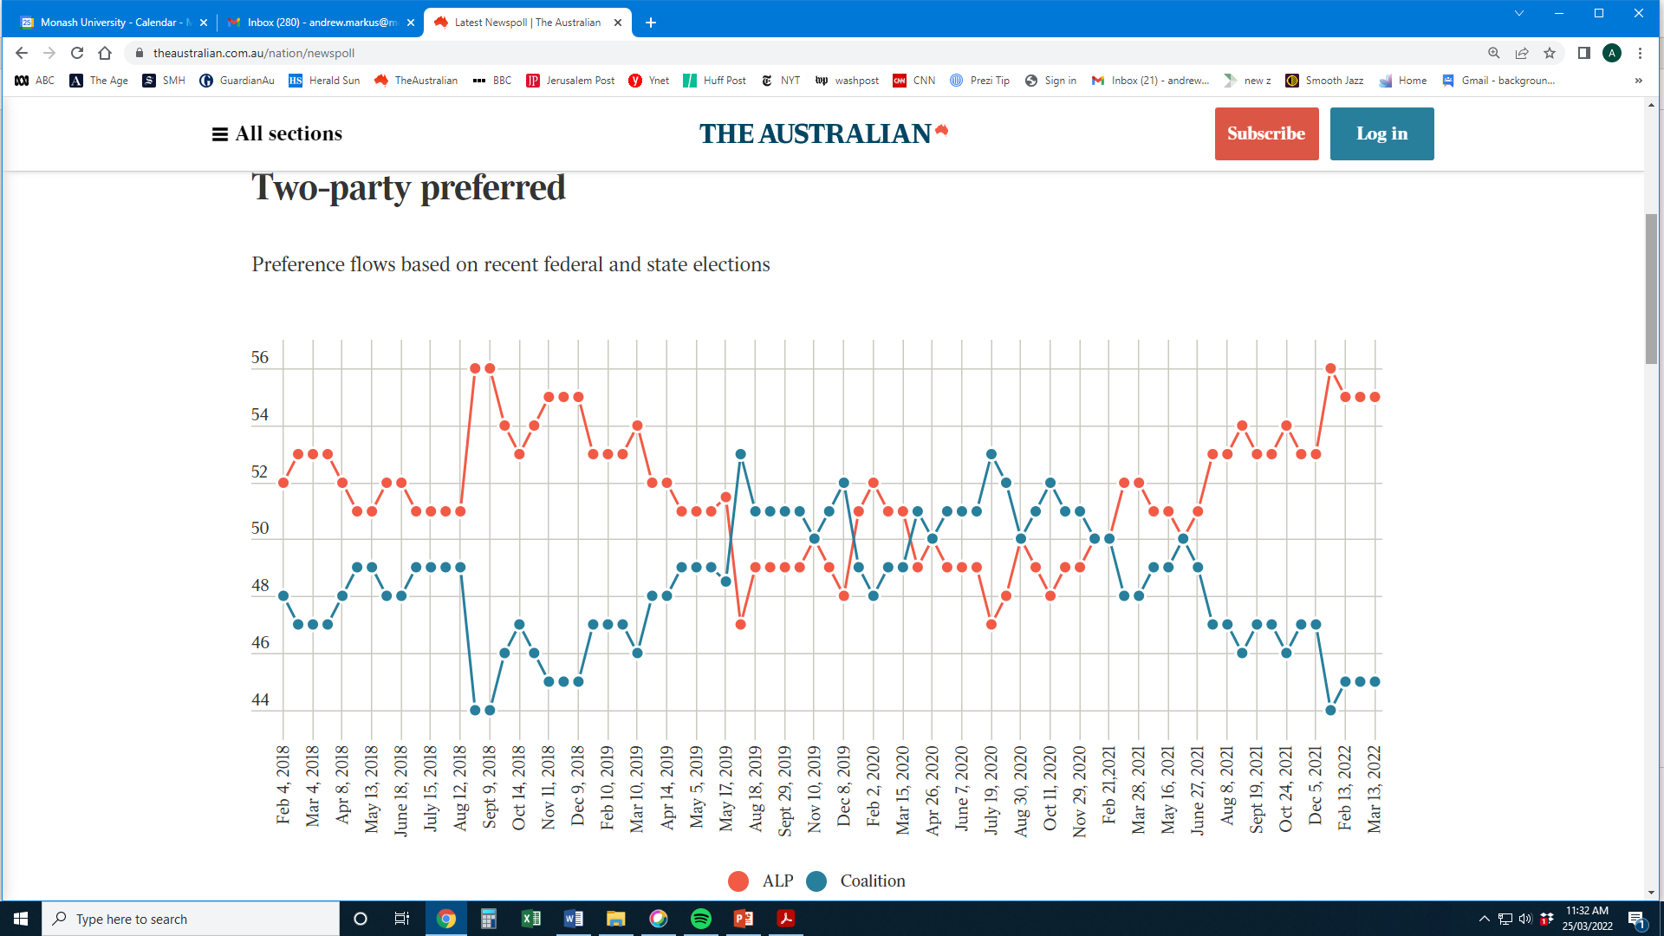

Slide 19
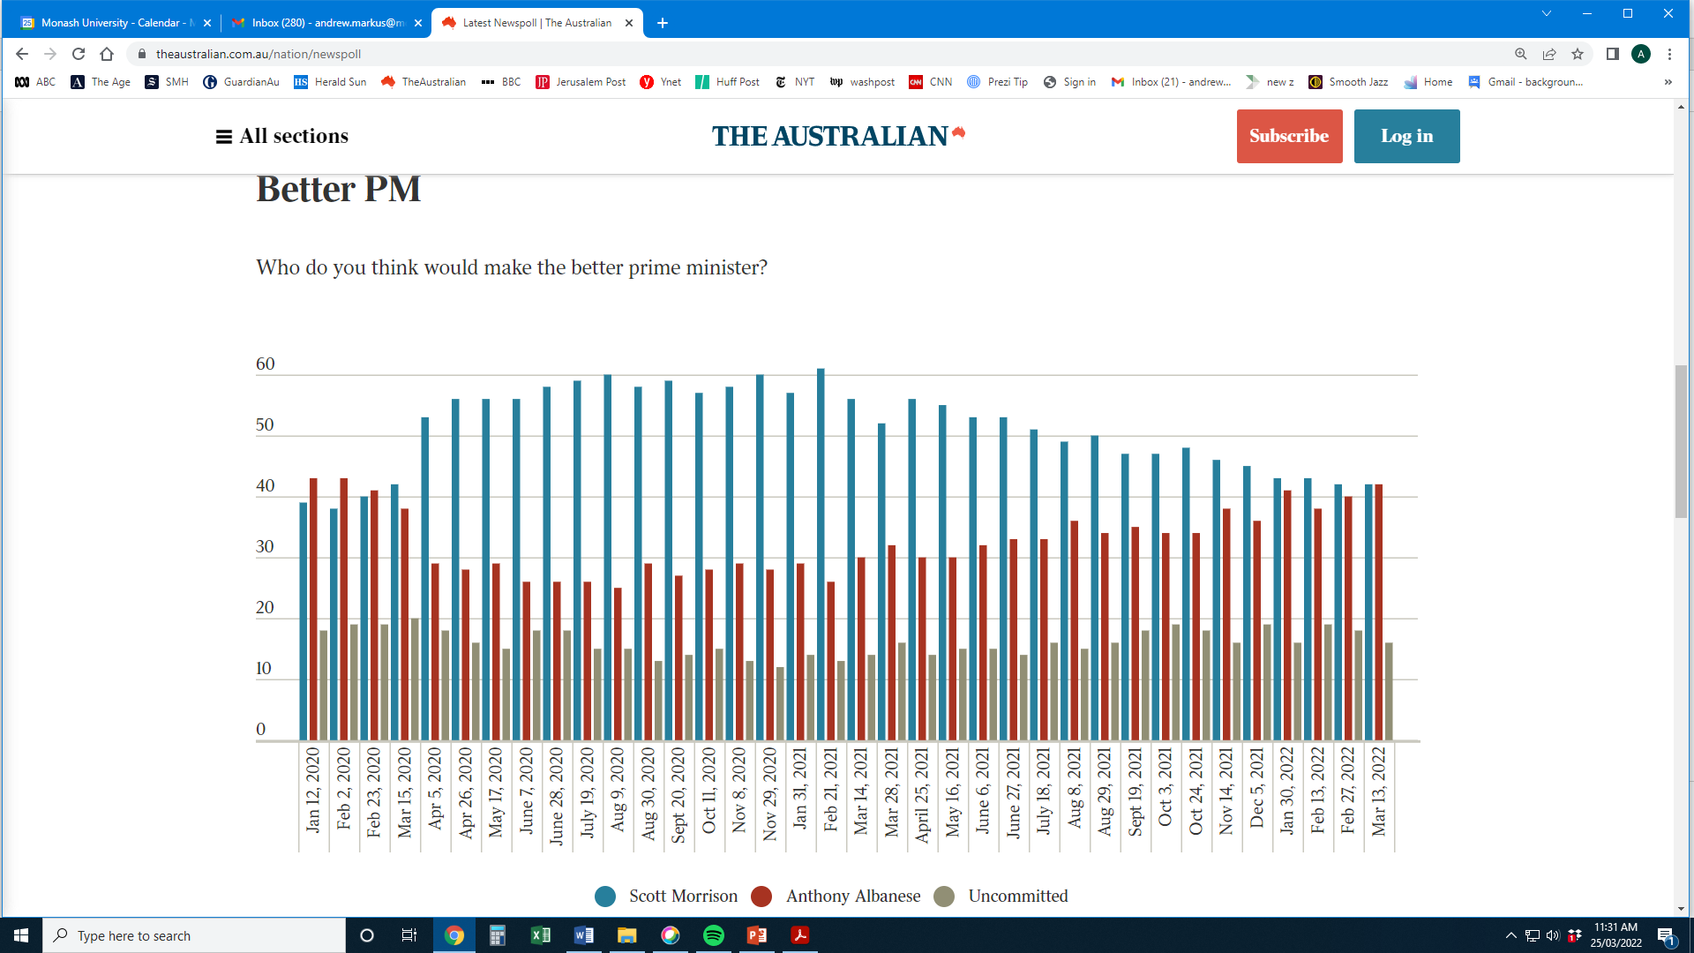

Slide 20
PREDICTING ELECTIONS IN AUSTRALIA

Slide 21
TRACK RECORD
2007-16 federal elections – 25/26 (96%) polls correctly predicted the result, although most overestimate 2PP support for Labor
2019 = polling failure; all incorrect – WHY?
“ … inadequately adjusted, unrepresentative samples. It is very likely the polls were skewed towards over-representing more politically engaged and better educated voters and this bias was not corrected. …”
Herding? Polling organisations have not provided access to their data and weighting
Reference: Australian Market and Social Research Organisations, Inquiry into the Performance of the Opinion Polls at the 2019 Australian Federal Election (October 2020)

Slide 22
2019 election
16 polls, all same range – all wrong
Galaxy Labor 51%-49%
IPSOS 51%-49%
Newspoll 51.5%-48.5%
Puzzle – all wrong in the same direction
Prof. Brian Schmidt: “all saying the same thing with a collective similarity that violates the fundamentals of mathematics”
Odds for this result, based on the samples for 16 polls = 100,000:1

Slide 23
Smoke and mirrors? Beware of small differences
Labor marked down in economic stakes, 4 April 2022
Popular support for Labor has ­fallen in the wake of last week’s federal budget … An exclusive Newspoll conducted for the Australian ahead of a likely May 14 election shows Labor’s primary vote falling three points to 38 per cent. …
With the Coalition improving a point to 36 per cent … , it has narrowed the contest from a six-point margin three weeks ago to a two-point difference as the election date nears.
The loss of support for Labor appears to have gone mostly to the Greens, which picked up two points to 10 per cent.
Once preferences are allocated, however, the two-party-preferred gap remains strongly in Labor’s favour – 54-46 per cent – with the gap tightening a point towards the Coalition.

Slide 24
Key points
Difficulty of interpreting
Especially electoral polling – high level of precision essential, data may not justify claims made
Social issues – important to take the “pulse of democracy” (George Gallup)
Danger: misleading findings.
Check how the sample was obtained – and its size
Look for surveys that establish trend
Look for surveys that provide a range of perspectives, not just one question

